Slide 1
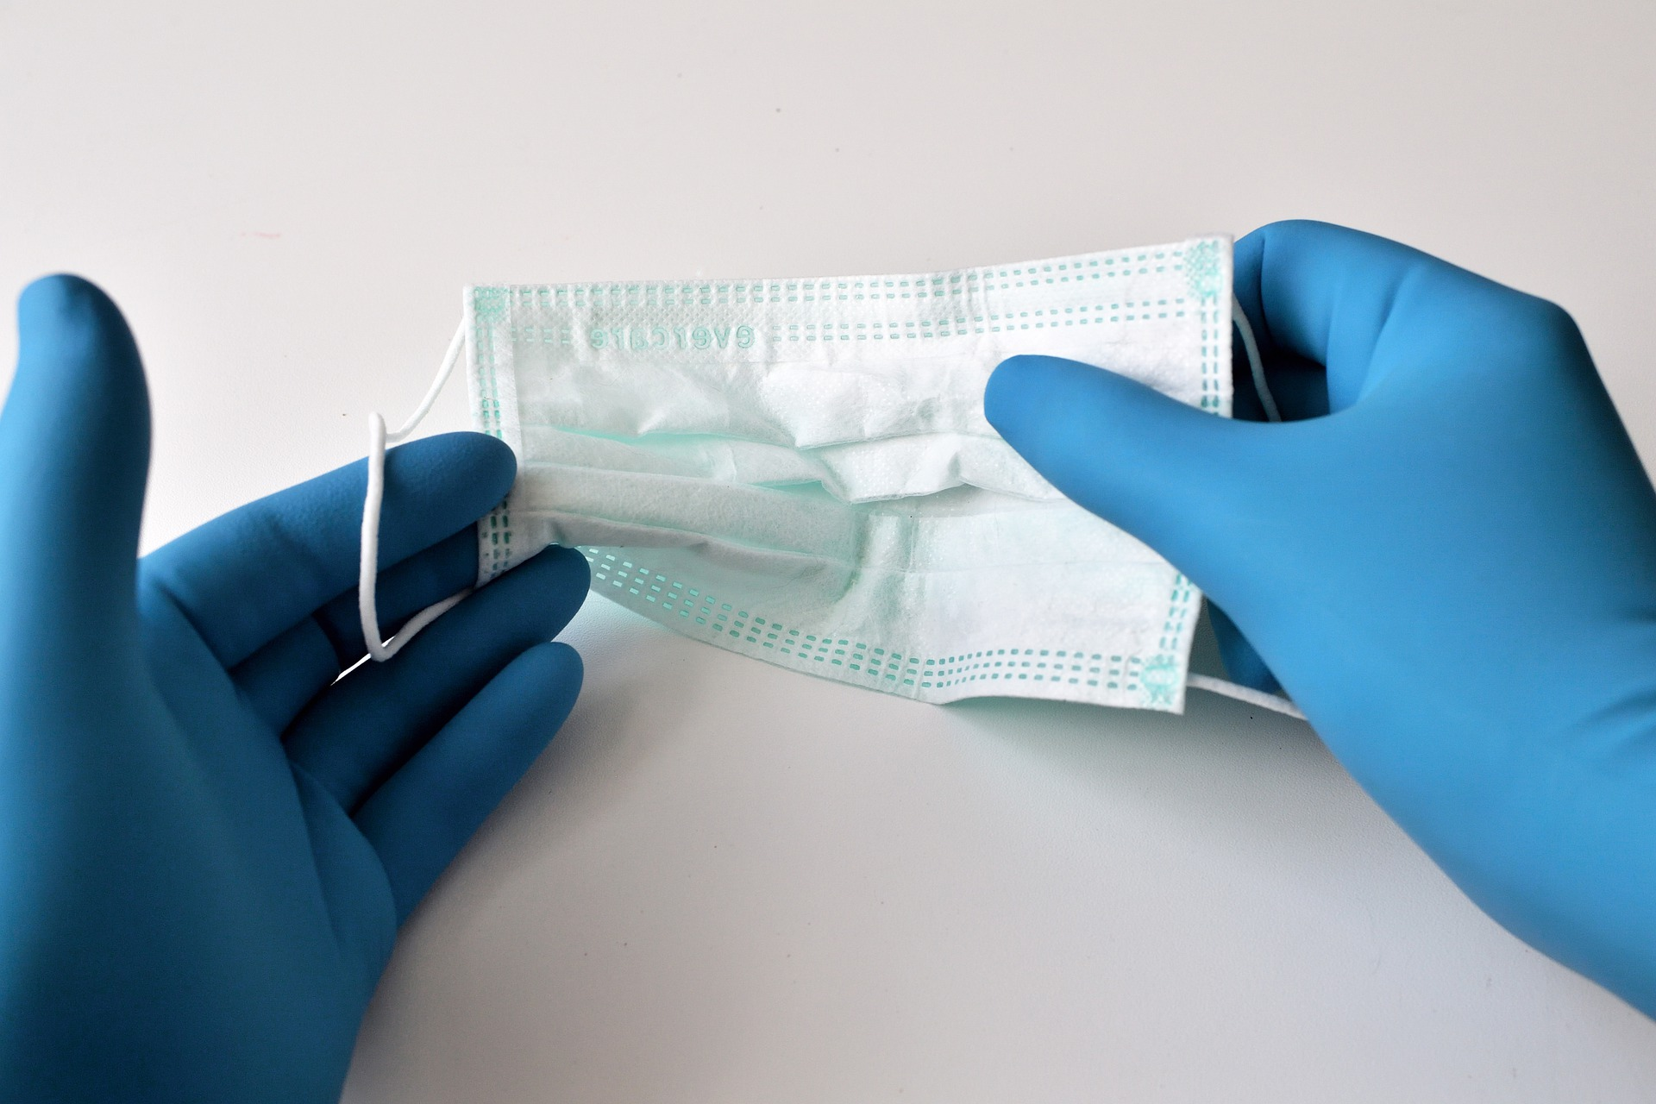
Federal COVID-19 Vaccine Requirement for Health Care Staff
Notes:
Right click -> Format Background -> Replace it with your picture ☺

Slide 2
Omnibus COVID-19 Health Care Staff Vaccination Interim Final Rule
The Centers for Medicare and Medicaid Services (“CMS”) issued an Interim Final Rule (“IFR”) requiring all CMS providers to fully vaccinate staff and other covered individuals by January 4, 2022.
Facilities that are regulated by CMS must comply. (We are regulated by CMS in order to participate as a provider in the Medicare and Medicaid program.)
According to CMS, this federal regulation preempts any state or local law (such as HB 702 passed by the Montana Legislature earlier this year).

Slide 3
Overview
Eligibility
  Impacted health care organizations
  Impacted staff and other covered individuals
Basic Requirements
Enforcement
Interactions with other agencies and state law
Key Dates
Recommended Actions
  Resources including checklists, templates and FAQs

Slide 4

Eligibility

Slide 5
Omnibus COVID-19 Health Care Staff Vaccination Interim Final Rule
The Centers for Medicare and Medicaid Services (“CMS”) issued an Interim Final Rule (“IFR”) requiring all CMS providers to fully vaccinate staff and other covered individuals by January 4, 2022.
Facilities that are regulated by CMS must comply. (We are regulated by CMS in order to participate as a provider in the Medicare and Medicaid program.)
According to CMS, this federal regulation preempts any state or local law (such as HB 702 passed by the Montana Legislature earlier this year).

Slide 6
Which organizations must comply?
Requirements apply to facilities regulated under the Medicare Conditions of Participation (CoPs):
Ambulatory Surgery Centers
Clinics, Rehabilitation Agencies, and Public Health Agencies as Providers of Outpatient Physical Therapy and Speech-Language Pathology Services
Community Mental Health Centers
Comprehensive Outpatient Rehabilitation Facilities
Critical Access Hospitals
End-Stage Renal Disease Facilities
Home Health Agencies
Home Infusion Therapy Suppliers
Hospices
Hospitals
Intermediate Care Facilities for Individuals with Intellectual Disabilities
Long Term Care Facilities
Programs for All-Inclusive Care for the Elderly Organizations (PACE)
Psychiatric Residential Treatment Facilities
Rural Health Clinics/Federally Qualified Health Centers

Slide 7
Who must be vaccinated?
The vaccination requirements apply to all eligible staff, both current and new, working at a facility regardless of clinical responsibility or patient contact, including:
  Facility Employees
  Licensed Practitioners
  Students
  Trainees
  Volunteers (including board members)
  Contracted Staff
The vaccination requirements also apply to staff who perform duties offsite (e.g. home health, home infusion therapy, etc.) and to individuals who enter into a CMS regulated facility
  Example: A physician with privileges in a hospital who is admitting and/or treating patients onsite
  Vaccination is the only option – this regulation does not allow a testing option (like OSHA rule for large employers) or antibodies from prior illness as demonstration of immunity
  This requirement does not apply to full time telework staff

Slide 8

Requirements

Slide 9
Requirements for Facilities
Process or plan for vaccinating all eligible staff
Process or plan for providing exemptions and accommodations
Process or plan for tracking and documenting staff vaccinations

Slide 10
How do exemptions work?
Basics for Religious Exemptions:
Basics for Medical Exemptions:
Facilities must develop a process for permitting staff to request a religious exemption
Facilities must ensure all requests for religious exemptions are documented and evaluated in accordance with applicable federal law and as a part of the facility’s policies and procedures
Facilities must develop a process for permitting staff to request a medical exemption
Facilities must ensure all documentation is signed and dated by a licensed practitioner
Documentation must contain all information specifying why the COVID-19 vaccines are clinically contraindicated for the staff member
Documentation must included a statement by the authenticating practitioner recommending the staff member be exempted

Slide 11
How do accommodations work?
CMS requires facilities to develop a process for implementing additional precautions for any staff who are not vaccinated
Potential accommodations for exempted staff could include, but are not limited to:
  Testing
  Physical Distancing
  Masking
  Source Control
In all cases, facilities must ensure that they minimize the risk of transmission of COVID-19 to at-risk individuals

Slide 12

Enforcement

Slide 13
Enforcement
CMS will work directly with the State Survey Agencies to regularly review compliance with Medicare/Medicaid regulations across multiple health care settings
  Montana’s State Survey Bureau (DPHHS) has not yet released information on implementation; however it will be required to follow CMS criteria
CMS expects State Survey Agencies to conduct onsite compliance reviews for the requirements in two ways:
  Recertification Surveys
  Complaint Surveys
Surveyors will check to determine if a facility has met the three basic requirements:
Having a process or plan for vaccinating all eligible staff
Having a process or plan for providing exemptions and accommodations for those who are exempt
Having a process or plan for tracking and documenting staff vaccinations
Accrediting Organizations (The Joint Commission, DNV) will also assess for compliance

Slide 14
Interactions with other regulations, state law (HB 702)
Per CMS and as interpreted by MHA legal counsel:
If your facility participates in the Medicare and Medicaid programs and is regulated under the CMS Conditions of Participation, Conditions for Coverage, or Requirements, then the CMS Omnibus COVID-19 Health Care Staff Vaccination Regulation takes priority and your facility is expected to abide by the requirements
Other considerations:
If facilities are not certified under the Medicare and Medicaid programs and therefore not regulated by the CoPs, then the Executive Order on Ensuring Adequate COVID Safety Protocols for Federal Contractors or OSHA COVID-19 Healthcare Emergency Temporary Standard apply
If none of the above regulations apply, then employers are subject to the OSHA Employer Emergency Temporary Standard (for facilities with greater than 100 employees
Per CMS, this regulation pre-empts any state law (i.e. HB 702) under the Supremacy Clause of the United States Constitution

Slide 15
Conflict with State Law: HB 702
HB 702 (signed into law April 2021) prohibits discrimination based on vaccination status, making it illegal for health care employers to require vaccinations of staff
Currently: 2 pending lawsuits in Montana challenging the constitutionality of HB 702
  Montana Medical Association-led lawsuit in U.S. District Court, Missoula District, progressing quickly but unclear if there will be a decision on substantive issues prior to 12/5/21 deadline to begin requiring vaccine
CMS asserts their regulation preempts any state law under the Supremacy Clause of the United States Constitution
Recommendation: Work toward compliance with CMS IFR

Slide 16
Potential results of noncompliance
Facilities that are out of compliance will be cited and provided an opportunity to return to compliance
  CMS has emphasized its focus will be on moving facilities into compliance
  CMS may use enforcement remedies, such as civil monetary penalties, denial of payment, and even termination from the Medicare and Medicaid program as a final measure

Slide 17
Medicare & Medicaid in Montana
524,000+ Montanans receive healthcare services through Medicare, Medicaid and Children’s Health Insurance Plan (CHIP)
Montana hospitals are the largest provider of care to these patients
  Services provided to these individuals represent 63% of all hospital patient revenues
  Termination from the Medicare and Medicaid programs would drastically reduce access to healthcare services for:
    Montanans over 65 years of age;
    Working and low-income families;
    Pregnant women and children; and
    People with disabilities
    Loss of Medicare and Medicaid services would negatively impact health and jeopardize the financial viability of Montana healthcare providers

Slide 18
Key Dates

Slide 19
December 6, 2021
Process or plan in place for vaccinating staff, providing exemptions and accommodations, and tracking and documenting staff vaccinations
All eligible staff must:
  receive first dose or one-dose vaccine; or
  request accommodations for medical reasons or religious beliefs
Staff who do not meet vaccination requirement or request accommodations may be terminated to ensure the facility does not lose its CMS certification
DEC. 6, 2021
January 4, 2022
JAN. 4, 2022
All eligible staff must:
  Receive second dose of two-dose vaccine; or
  Receive approval of requested exemption
Facilities must provide accommodations to all exempted staff
Staff who do not meet vaccination requirement or receive an exemption may be terminated to ensure the facility does not lose its CMS certification

Slide 20
Recommended Actions

Slide 21
Action Items
Conduct a review of facility policies addressing vaccine requirements.
Review accommodation protocols for those employees that are currently unvaccinated for any reason or for whom vaccination status has not been confirmed.
Review tracking and documentation procedures for employee vaccinations.
Develop a draft policy to be implemented prior to the December 5, 2021 deadline for initial vaccination shots.
  Ensure supply availability for vaccines to be offered on-site for staff.
  Prepare forms for staff and other personnel to complete prior to December 5, 2020 confirming (1) vaccination status with proof of vaccination; and (2) exemption requests.

Slide 22
Action Items:
Sample Templates
COVID-19 Vaccination Policy (Template)
COVID-19 Employee Vaccination Verification and Accommodation Request Form
COVID-19 Vendor/Contractor Vaccination Status Attestation Form
COVID-19 Individual Vendor/Contractor Vaccination Status Attestation Form
COVID-19 Health Care Staff Vaccination Requirements FAQs

